Slide 1
CS-773 Paper Presentation Filter Caching for free: The untapped potential of the Store Buffer
Prajeeth.S Team(#4) Spectredown
190050117@iitb.ac.in

Slide 2
Plan:
Introduction to SQ/SB
Issues with current store queues
Store Buffer Cache
Coherence and Synonyms
Results

Slide 3
Store Queue(SQ):
SQ allows ordering of stores - TSO memory model
Two purposes
SQ - In-order store commit
O3 loads fetch from uncommitted stores done before load

Slide 4
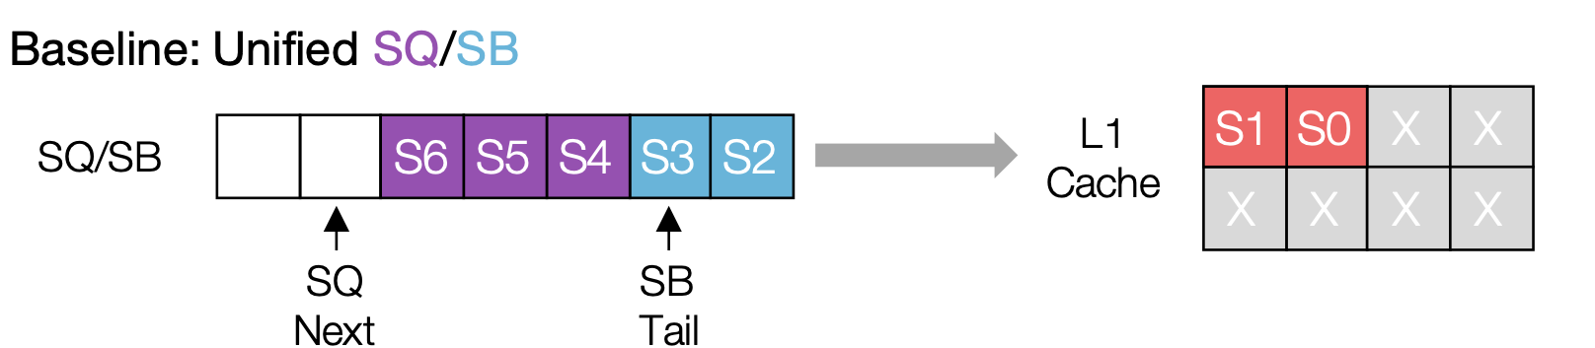
Store Buffer(SB):
Stalls at SQ during commit
To reduce latency - stores moved from SQ to SB on commit
Merged with SQ as circular FIFO queue
Image taken from here

Slide 5
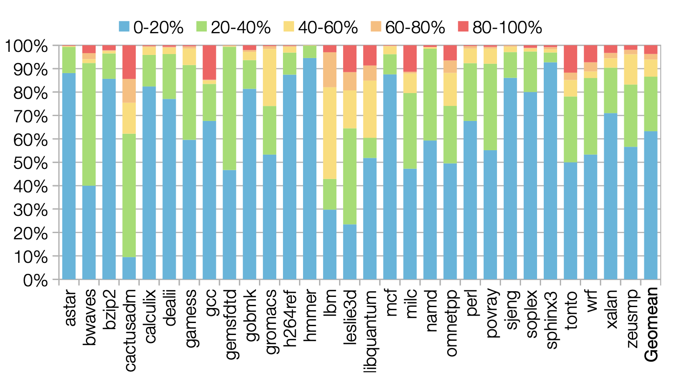
Scope for Improvements in SQ/SB
Low Utilization due to:
Small size
Aggressive eviction policy
Image taken from here

Slide 6
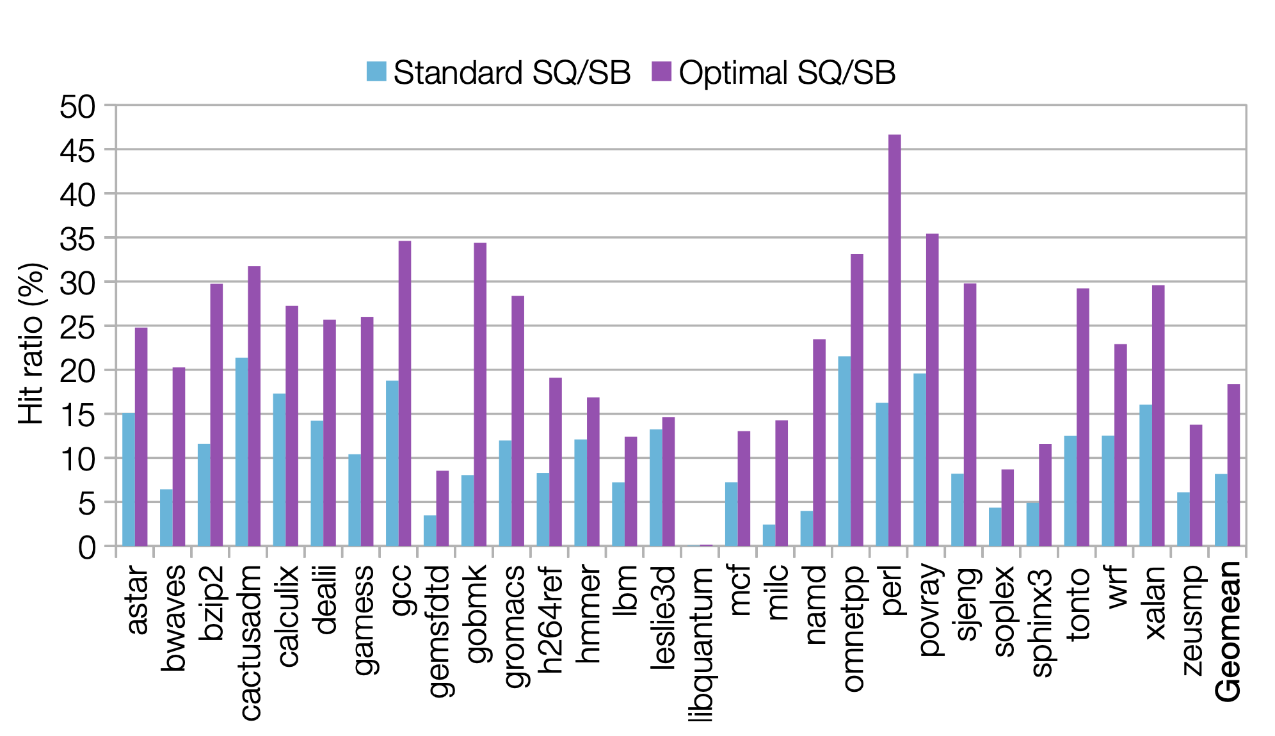
Scope for Improvements in SQ/SB
Optimal SQ/SB has a much higher hit ratio
Image taken from here

Slide 7
Scope for Improvements in SQ/SB
Current design has low hit ratio in SQ/SB
Reduces benefit of low latency, low energy
Large fraction of Load’s can be fetched from SQ/SB rather than L1

Slide 8
Filter Cache: Overview
A very small cache between CPU and L1.
Lower latency and power
But, small size => low hit rate
High evictions and writes on load => bad performance

Slide 9
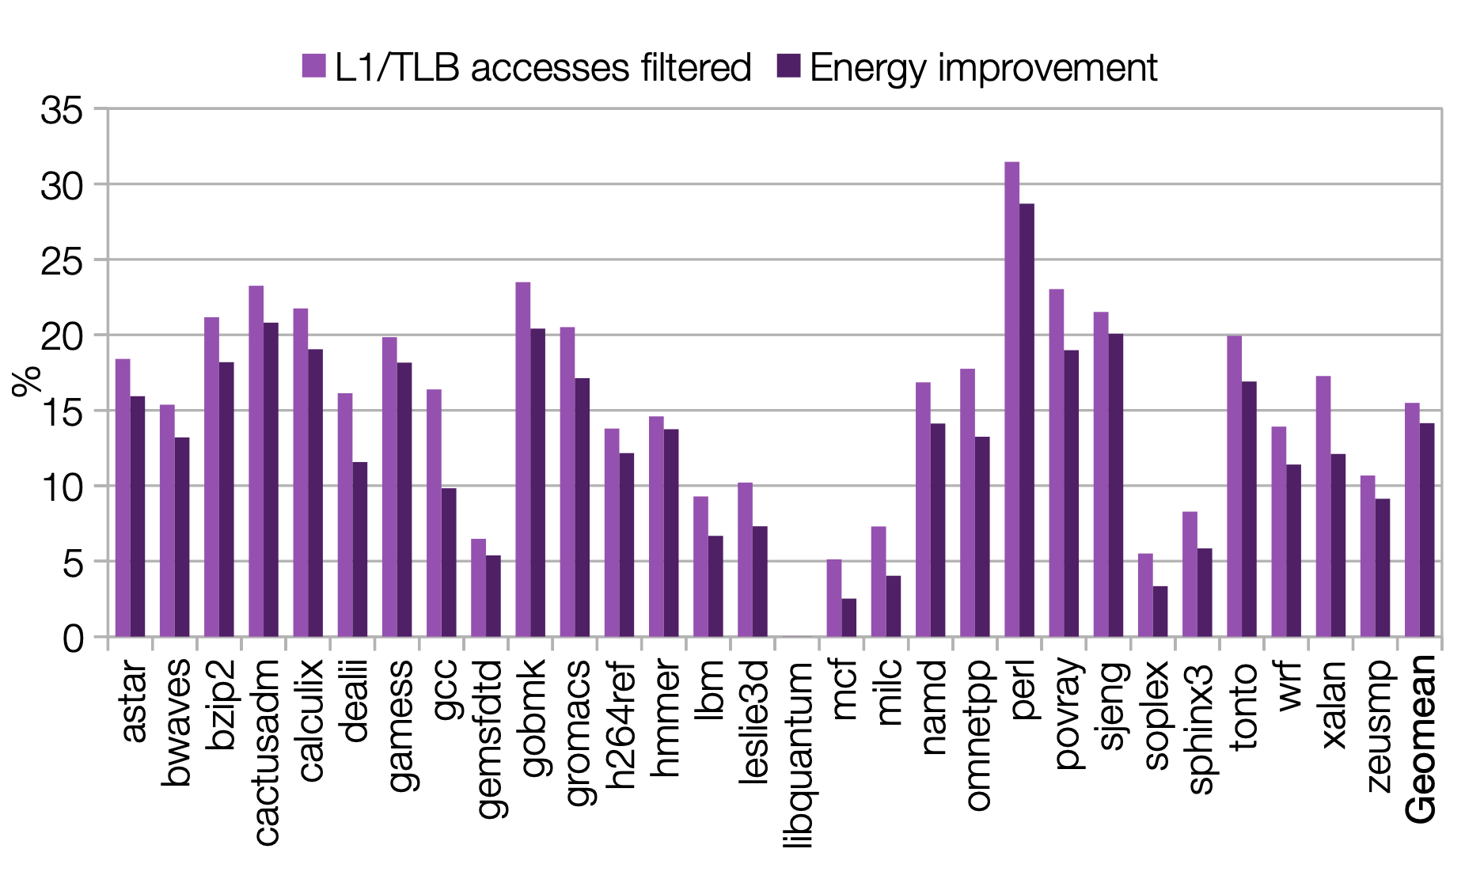
SQ/SB as Filter Cache?
All stores go through SQ/SB
Must be probed on loads
SQ/SB pays filter-cache costs without benefits
Image taken from here

Slide 10
Reducing L1/TLB accesses using SQ/SB
If data in SQ/SB => no L1/TLB access => low latency, energy
If miss then sequential access of SQ/SB & L1 => high latency
Fix: Accurate prediction of presence in SQ/SB
Need maximum data in SQ/SB => filter cache

Slide 11
Store Buffer Cache(SBC)
A portion of the unified storage SQ/SB -> S/QBC
On write to L1, move from SB to SBC
Moving from SQ->SB and SB->SBC needs only 1 extra head-pointer
Higher hit-rate provided -> eviction from cache when extra space needed

Slide 12
SBC Synonyms
VA->PA translations needed to avoid synonyms
SQ/SB hold both PA and VA.
If a load hit on a SBC entry whose PA is not known, no extra TLB accesses needed.

Slide 13
SBC Coherence: Naive Approaches
MESI Protocol
2 Naive solutions:
Forward cache invalidation to S/QBC
Flush SBC on any invalidation or downgrade

Slide 14
SBC Coherence: Optimization 1
Bulk flush only on downgrade from Modified state:
Either M->I
Or M->S since we can’t track future changes
Or eviction of cache line in M state
No more flushes on invalidation/eviction of other states compared to Naive #2

Slide 15
SBC Coherence: Leading to Optimization 2
Life of Cache lines >> Life of SBC entries
A downgrade of M state might not be in cache
Store “epoch” of data -> flush SBC entries with same epoch
Use multi-colored dirty bits
For 2 colors - Flush entries from SBC having the same color as that of the L1 line

Slide 16
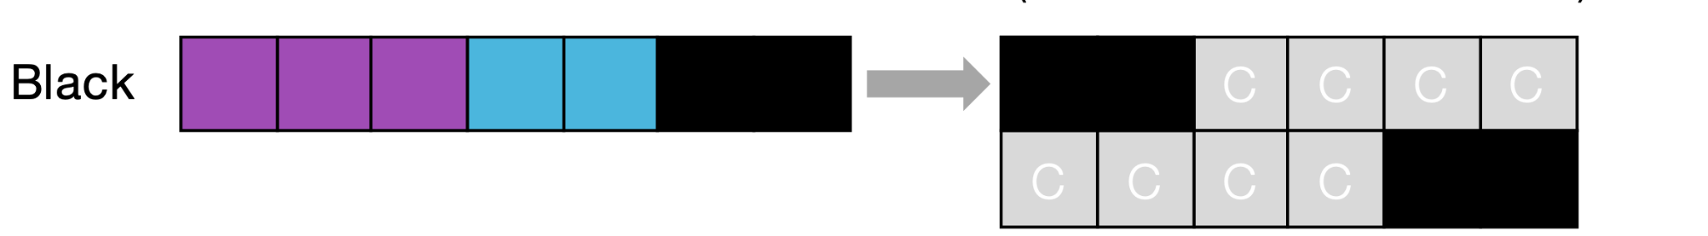
SBC Coherence: Optimization 2
SQ, SB, SBC/SBC (Assuming 2 colors)
Black epoch write: Dirty Data from SB written to L1 with black dirty bit set, moved to SBC
Image taken from here

Slide 17
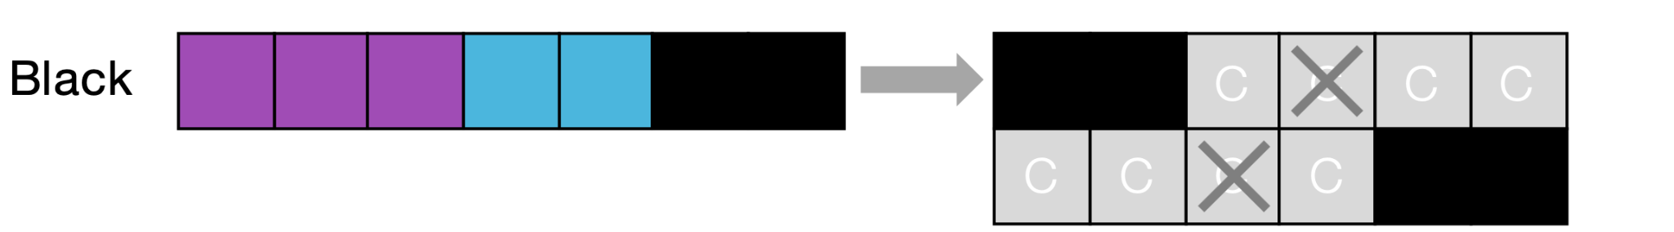
SBC Coherence: Optimization 2
SQ, SB, SBC/SBC (Assuming 2 colors)
Black epoch - Invalidation/Downgrade of non-black data: No effect on SBC
Image taken from here

Slide 18
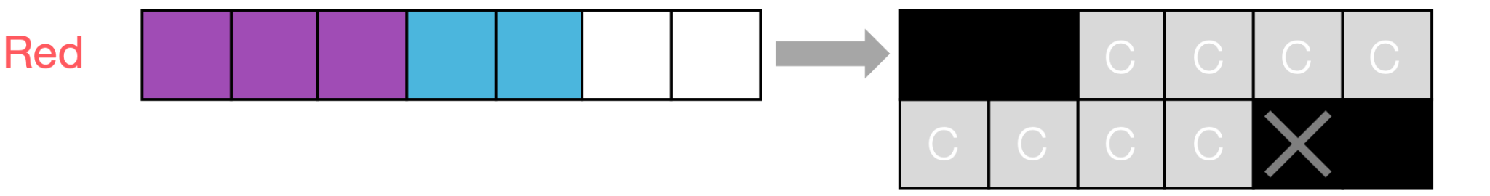
SBC Coherence: Optimization 2
SQ, SB, SBC/SBC (Assuming 2 colors)
Black data Invalidation/Downgrade: Flush all entries in SBC that are black and change epoch to red
Image taken from here

Slide 19
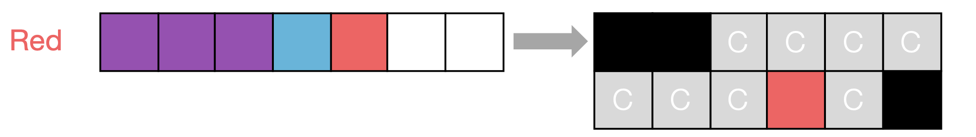
SBC Coherence: Optimization 2
SQ, SB, SBC/SBC (Assuming 2 colors)
Red epoch write: Dirty Data from SB written to L1 with red dirty bit set, moved to SBC
Image taken from here

Slide 20
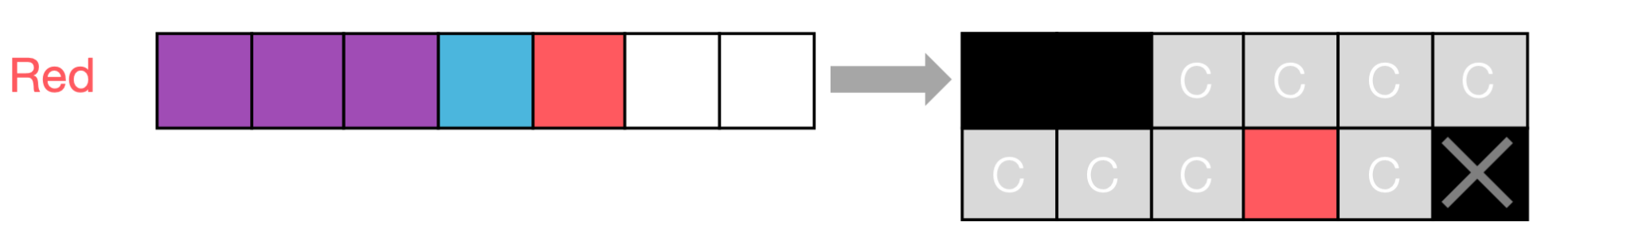
SBC Coherence: Optimization 2
SQ, SB, SBC/SBC (Assuming 2 colors)
Red epoch - Invalidation/Downgrade of Black data - no effect on SBC
Image taken from here

Slide 21
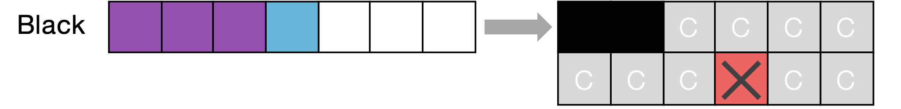
SBC Coherence: Optimization 2
SQ, SB, SBC/SBC (Assuming 2 colors)
Red data Invalidation / Downgrade - Flush out the red data from SBC, change epoch to black
Image taken from here

Slide 22
SBC Coherence: Optimization 2 Extensions
2 colors can generalized to any number of colors.
N bits gives 2^N - 1 colors
Alternative:
Red -> maybe in SBC
Black -> not in SBC
On flush switch all red->black in cache
Red shows only last epoch at any time

Slide 23
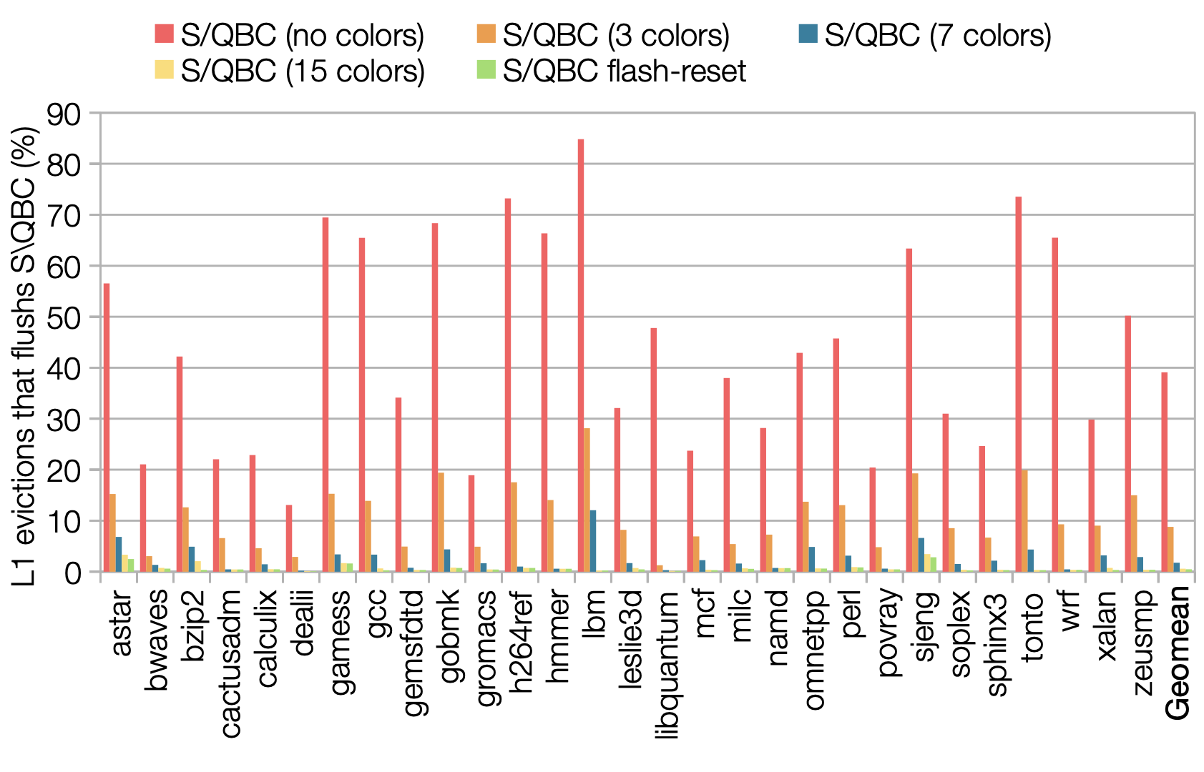
SBC Coherence: flash-rest v/s 3 colors
Image taken from here

Slide 24
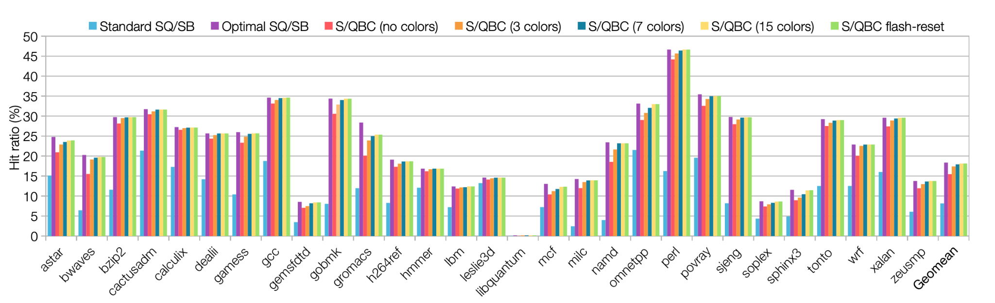
SBC Coherence: flash-rest v/s 3 colors
7/15/flash reset almost optimal, 3 colors good enough
Image taken from here

Slide 25
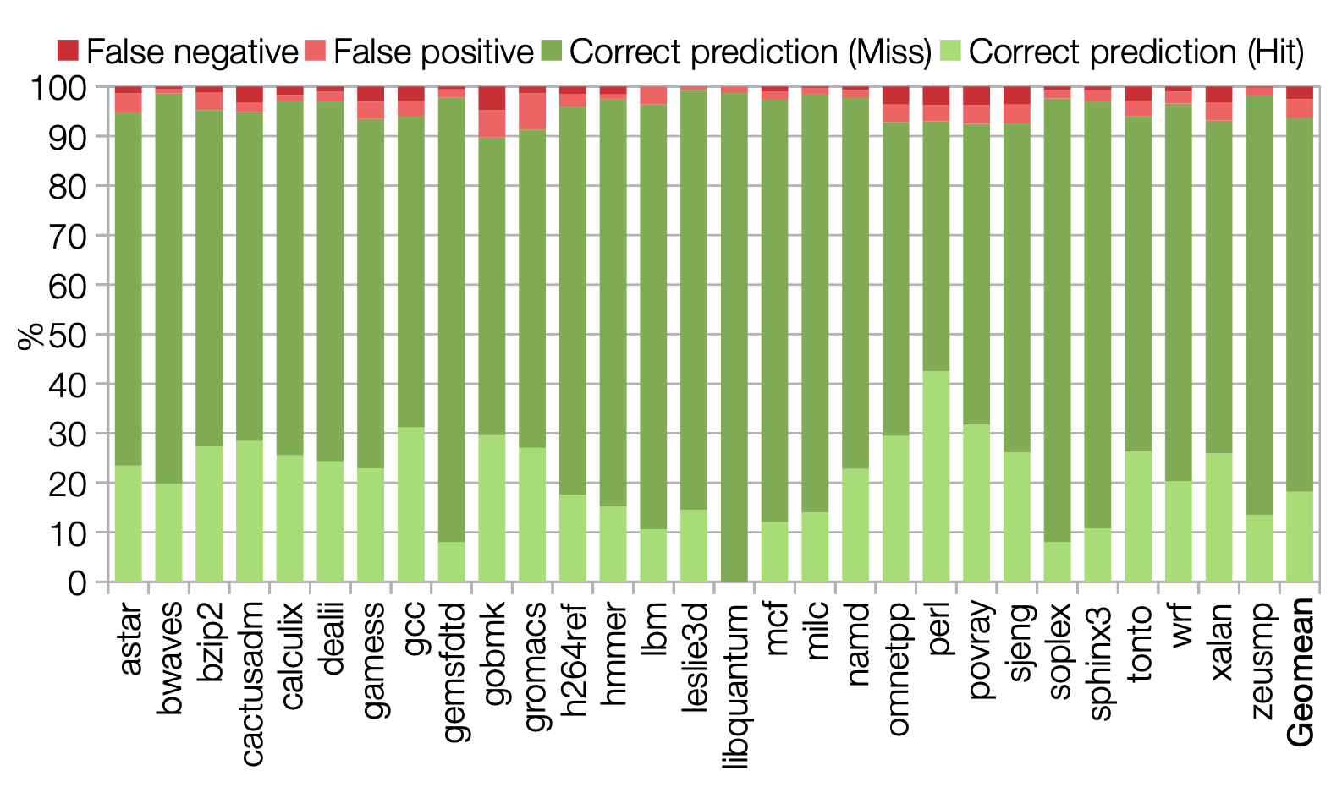
Predicting hits: Memory Dependence Predictor
Modern systems can predict which level of cache data is in.
Can be used to reduce latency due to filter cache
Image taken from here

Slide 26
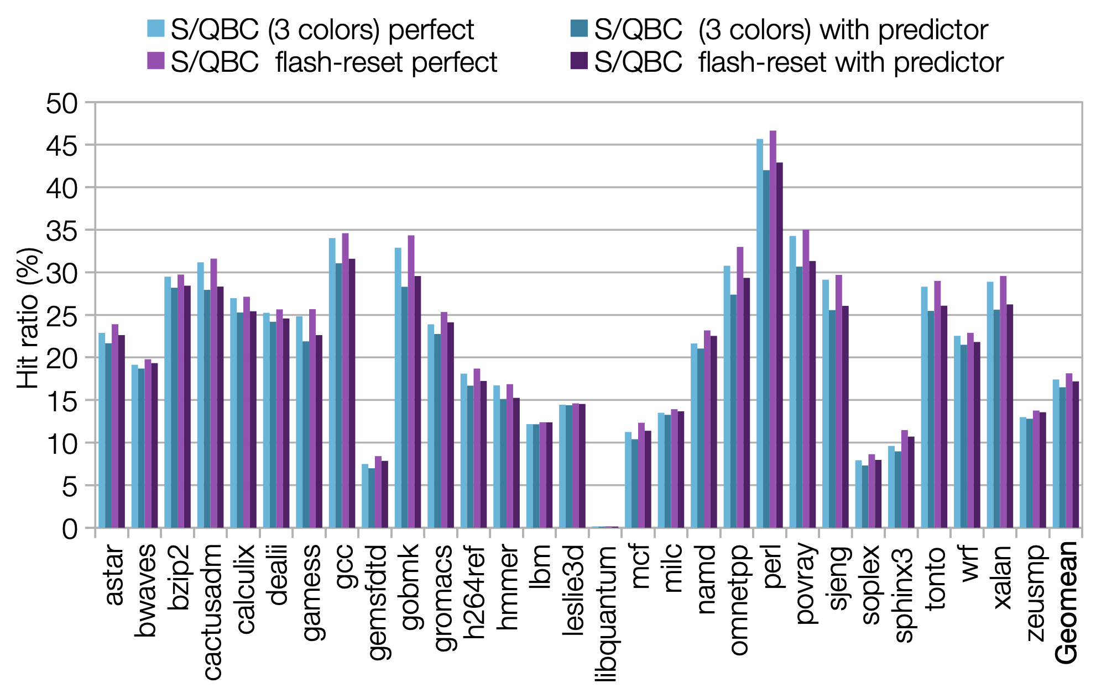
Results: With Predictor
Memory dependence predictor reduces hit ratio
Image taken from here

Slide 27
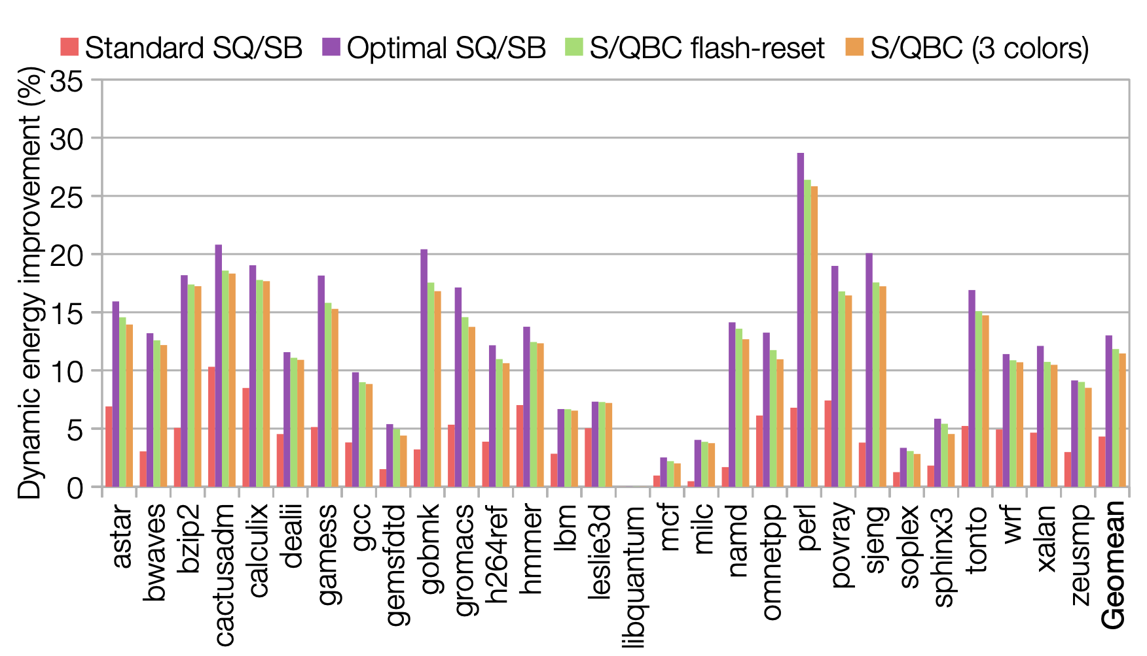
Results : Energy Savings
Dynamic Energy Savings
Image taken from here

Slide 28
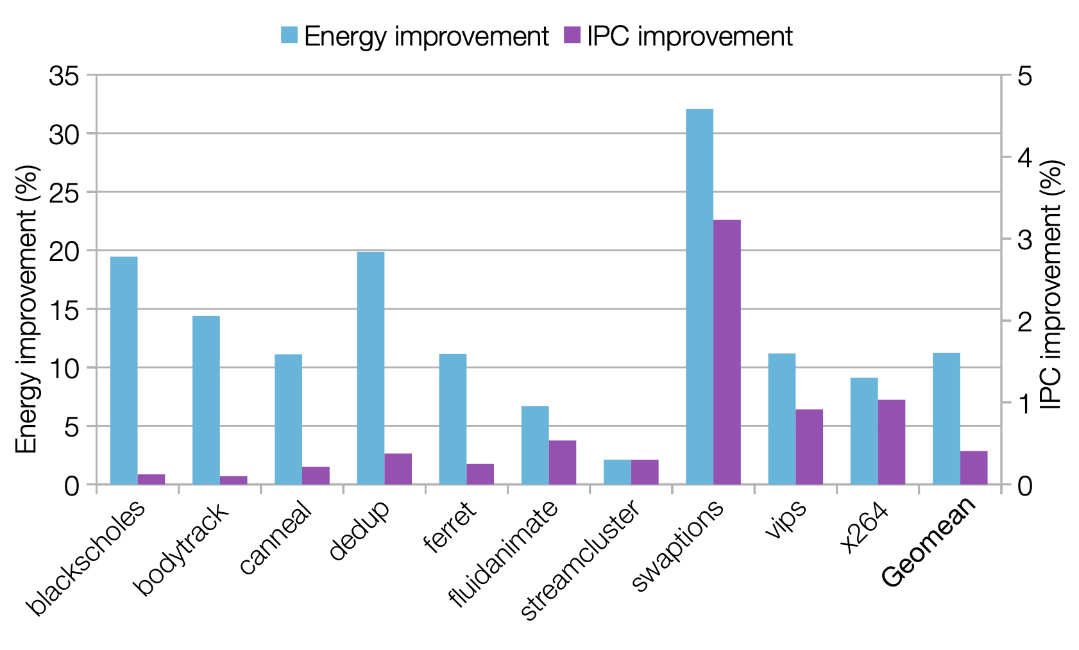
Results - Energy Savings
Parallel Workloads
Image taken from here

Slide 29
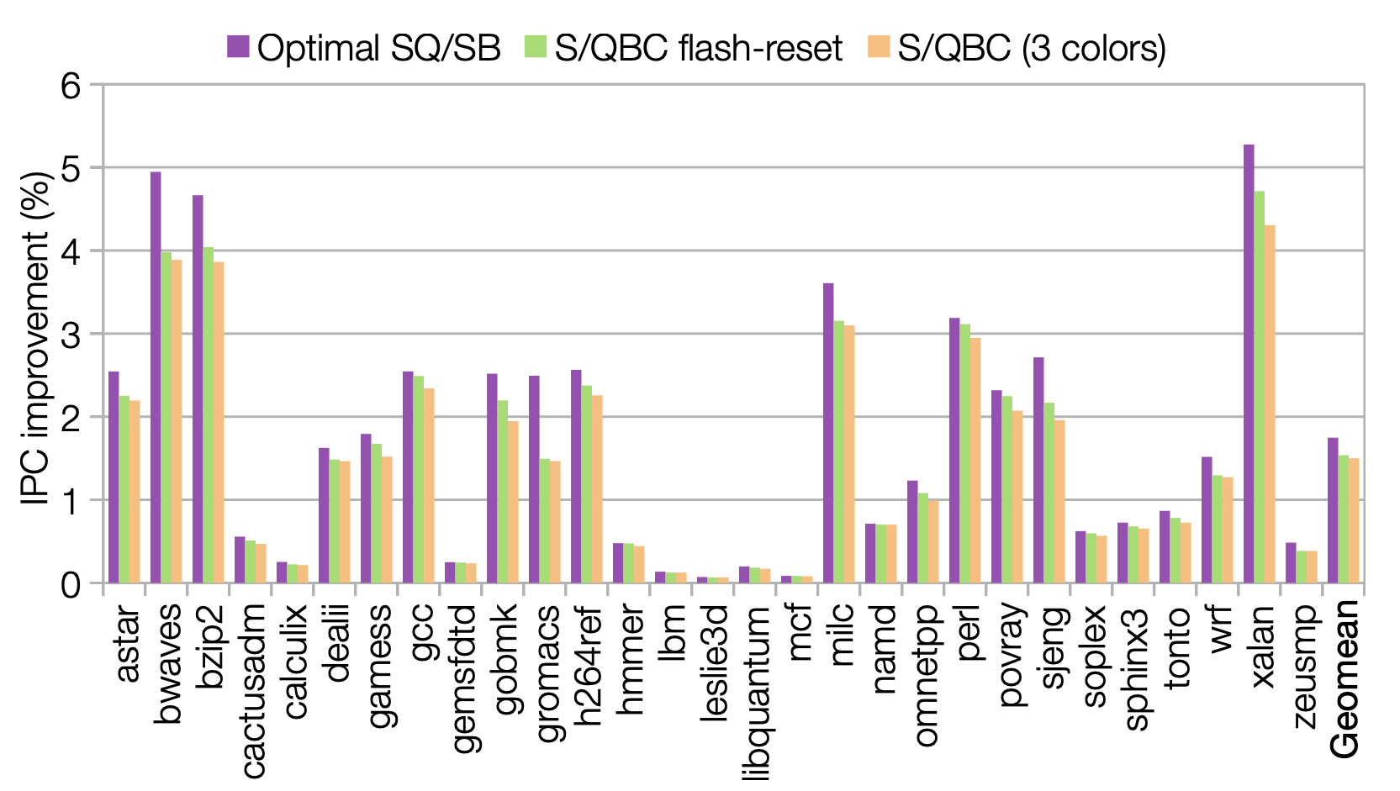
Results - IPC
IPC Improvements
Image taken from here

Slide 30
Best and Worst cases
Read Locality(Y/N) | Predictor Accuracy(Y/N) | Energy | Performance
Y | Y | Improvement | Improvement
Y | N | Same | Same
N | Y | Same | Same
N | N | Same | May Reduce

Slide 31
Points to Discuss:
Coherence for weaker memory models?
Claims that Memory Dependence Predictors already exists. Is it true?

